Slide 1
Team 05
WESTWORLD
Khushi Bhuwania Piyush Talreja
Tian Xie Tirth Parekh Varsha Reddy

Slide 2
Milestone: 1
Main takeaways/learnings : collecting data, building ML models, building inference service, teamwork.
Design choices in the milestone :
1. What data features do we use and store. We had to keep in mind the storage and also what features are important for the model. We ended up storing features user_id, movie_id, rating, gender, age and occupation. We used 30M log entries for initial model. How we split the data for training and validation. Assumption was that the data is sequential in the kafka pipeline.
2. Learned about various recommendation algorithms. Tried Collaborative filtering (user and item) and SVD. We went on with SVD based model as it performed better, had lower inference cost, fast training time and smaller model size.
3. Team work: Learned about each other expertise and decided on where and when meetings will be held and what mode of communication will be used in the future.
What would we have done better? - Explore various other recommendations algorithms and stored data in databases instead of files. This would have made things easier in the future.

Slide 3
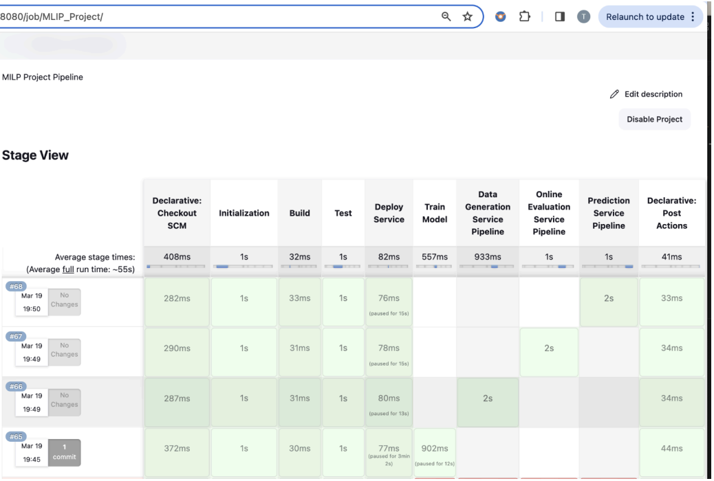
Milestone 2
Main takeaways:
Importance of CI/CD pipeline, testing, evaluation, software quality, system availability and stability
Design choices:
Post every commit, Jenkins pipeline was auto triggered, built and test cases were run to ensure sanity
Since we used a microservices architecture, our Jenkins pipeline was configured to deploy the said service
Our pipeline also automated the model updates, training model on latest data once a day
Could have done better:
Include a rollback step in the pipeline to move back to an older version of the code with just one click

Slide 4
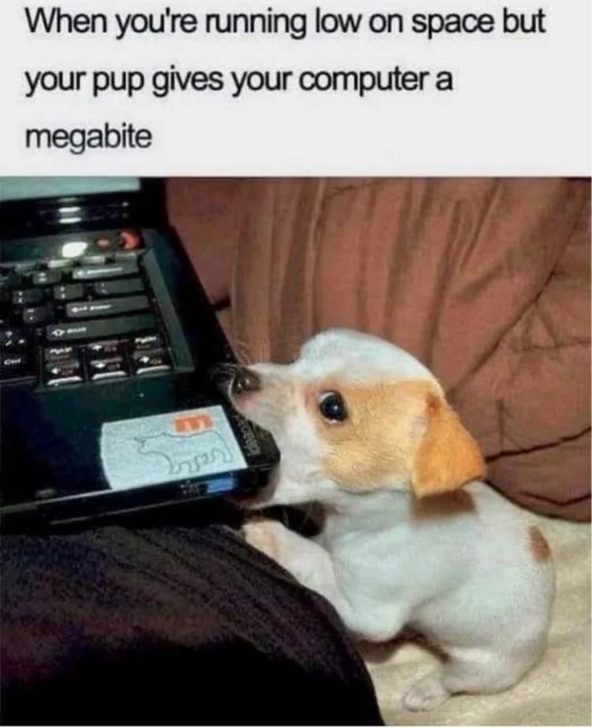
Milestone 3
Problems with Local Deployment
Solution?
Resource Limitations
Limited CPU (utilization was above 95%)
Storage
Maintenance Overhead
Manual efforts (model updates, model switching)
Availability Concerns
Not scalable

Slide 5
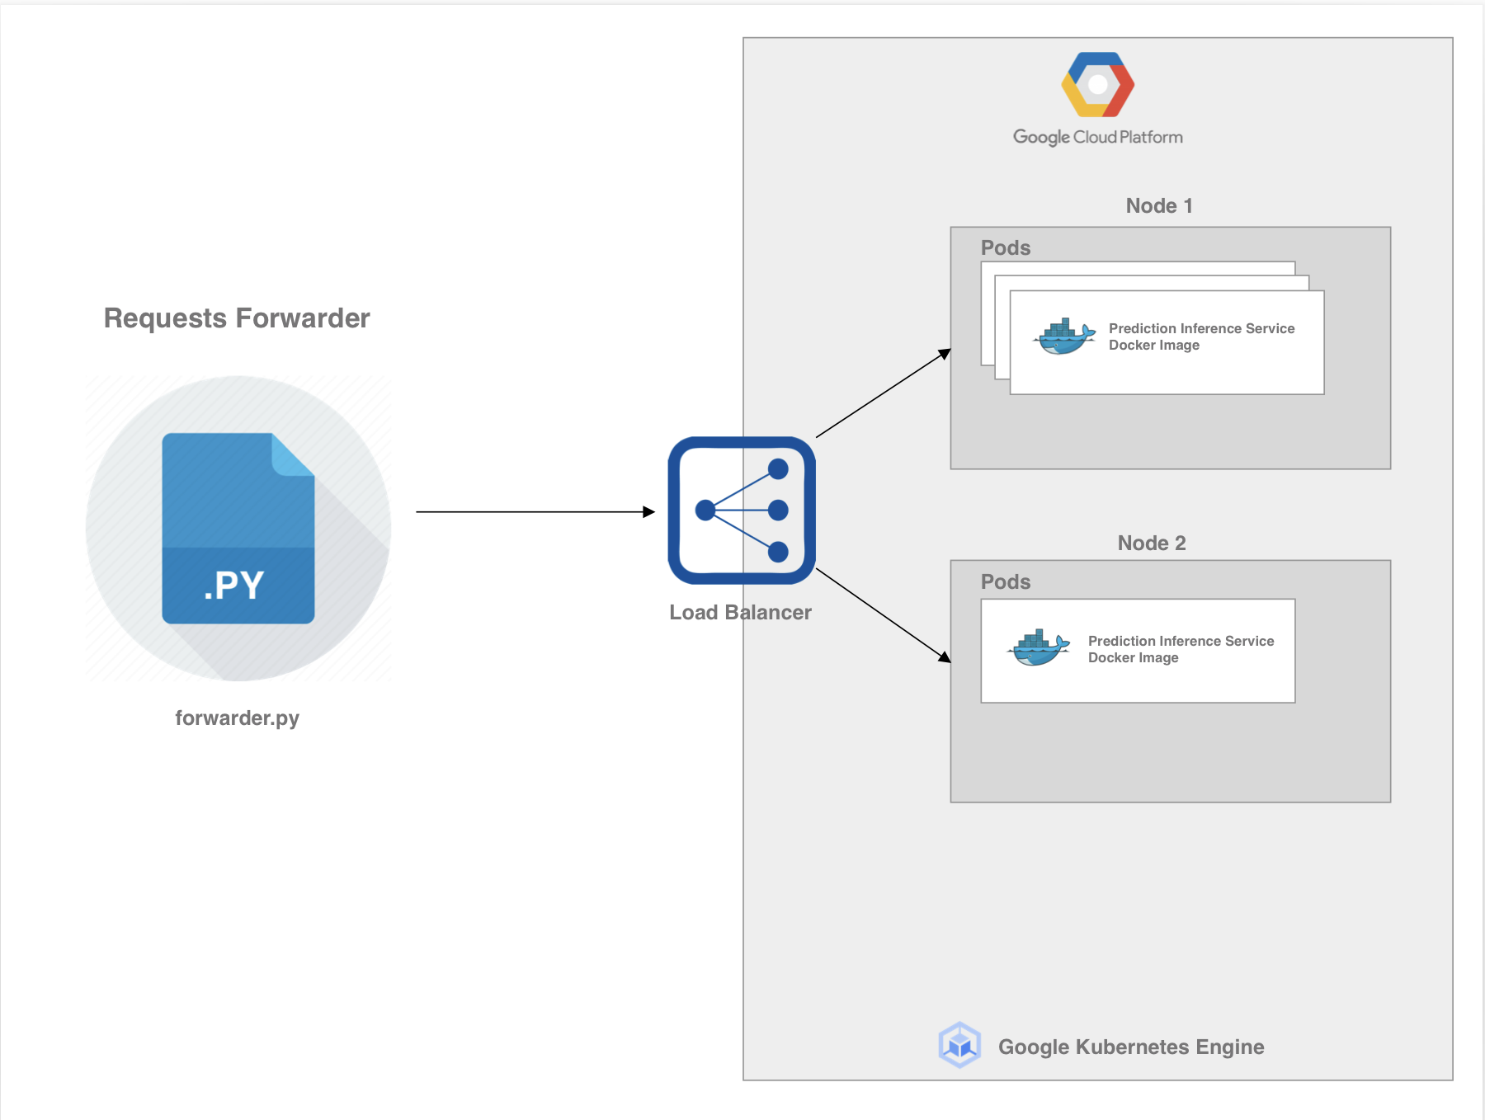
Deployed Inference Service on Cloud
Scalability
Deployed our service across 2 nodes
Each node was configured to host multiple pods
Load balancer to evenly distribute load.
Zero-Downtime Deployments
Utilizing Kubernetes for zero downtime
Enabled us to maintain uninterrupted service availability even during updates, with the ability to roll back instantly to a stable release if necessary.
Availability: 99.8%

Slide 6
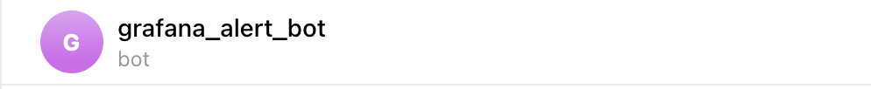
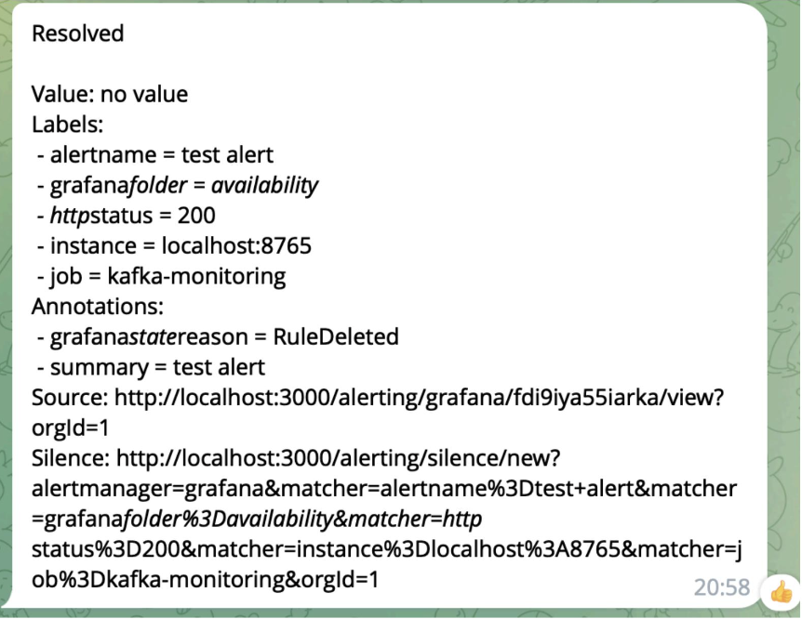
Monitoring
Decided to set up telegram bot

Slide 7
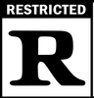

Milestone 4 - Fairness
Fairness Focus
Prevent adult movie recommendations to children under 21.
Dataset Filtering
Exclude underage viewers of adult-rated movies.
Validation Checks
Ensure recommendations for children are age-appropriate.
Design Improvements
Monitor and refine model to reduce unfair recommendations.
Handling Exceptions
Automatically replace adult movies with suitable alternatives for underage viewers.
Notes:
The idea of fairness for us was towards children under the age of 21. We planned to ensure fairness in terms of not giving adult movie recommendations to children. We implemented this by filtering our dataset in turn removing the instance of any underaged child watching an adult movie.We have also added a check on recommendation to validate if any movie recommended to an underaged child is adult rated. Our design improvement goal would be to add monitoring on the unfair recommendations towards children to improve the model and limit such responses. This would increase the trust of parents and adults in the recommendation system and there would be no negative impact on children. For now we have hardcoded the replacement of the adult-rated movie to a famous movie but would intend to set the recommendation to the next non-adult movie in line after selecting a given set of movies.

Slide 8
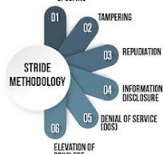
Milestone 4 – Security
STRIDE threat modeling
Security Issue 1: Dos
attackers send thousands of simultaneous requests to recommendation API
retrieve user request frequency from Kafka stream log
introduce a rate limiter, 60 requests per minute for each client
Security Issue 2: Review Bomb
large number of users deliberately post negative reviews or low ratings for a particular movie to manipulate its perceived popularity
monitor the `/rate` requests, detecting abnormal ratings for a certain movie
Ratings and users involved during a review bomb will not be included in future model training

Slide 9
Collaboration
Bi-weekly meetings (Hybrid mode)
Assigned tasks based on the strengths
Openly communicated when stuck on a task for long time
Sometimes we didn’t plan things well in advance, so sometimes we had to overload as we came closer to deadlines
Last minute submissions

Slide 10
THANK YOU!

